Slide 1

Springfield School
Anti-Bullying Policy
Written by pupils, for pupils

Slide 2
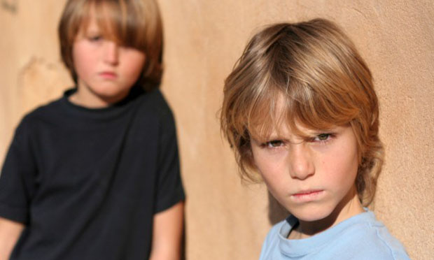

What is Bullying?
Bullying is when someone is unkind to someone else.
It can be once, or over and over again.

Slide 3

What are the effects of bullying?
Bullying can make someone feel insecure, upset or unhappy
It can make a person feel like they’re not wanted or worthless
It can make someone worry
Bullying can force people to change what they want to do
It can make people feel miserable or stay off school
Bullying is not ok

Slide 4
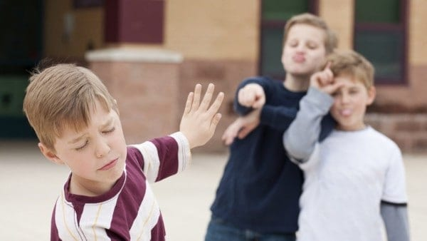
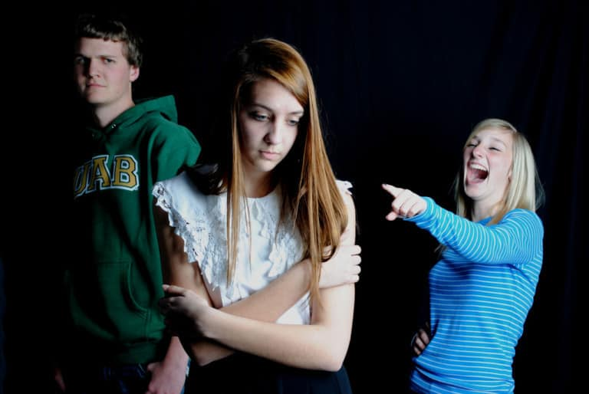
Bullies may say something about your…
Size
Height
Colour of your skin or hair
Voice or accent
Clothes
Family
(Or anything that makes you feel uncomfortable, sad or scared)

Slide 5

What does bullying look like?
Hitting
Touching
Calling names
Rude language
Stealing or damaging
Leaving someone out
Unkind words or text messages

Slide 6

Where can it happen?
Bullying can happen:
In class
In the playground
In the corridor
On the way to another room or class
On the bus
In the changing rooms
When playing on-line games or by text
Or just about anywhere…

Slide 7

What should I do if I’m being bullied?
Tell your teacher or TA (or any adult in school) if you’re too shy, tell one of your friends and they can tell your teacher for you
Tell someone at home
Tell a friend or any trusted adult
Write a note and put it on your teachers desk
Call Childline anytime on 0800 1111
or www.childline.org.uk

Slide 8
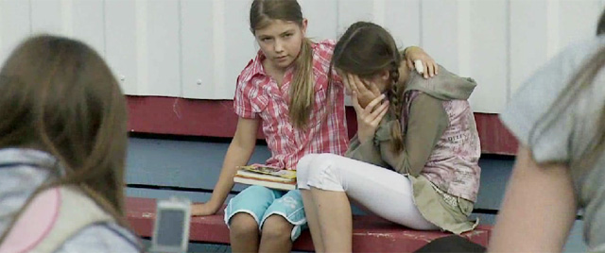
What should I do if I see someone being bullied?
Comfort them, ask if they’re ok
then
Tell your teacher or TA (or any adult in school) if you’re too shy, tell one of your good friends and they can tell your teacher for you
Tell someone at home
Tell a friend
Write a note and put it on your teachers desk
Call Childline anytime on 0800 1111

Slide 9
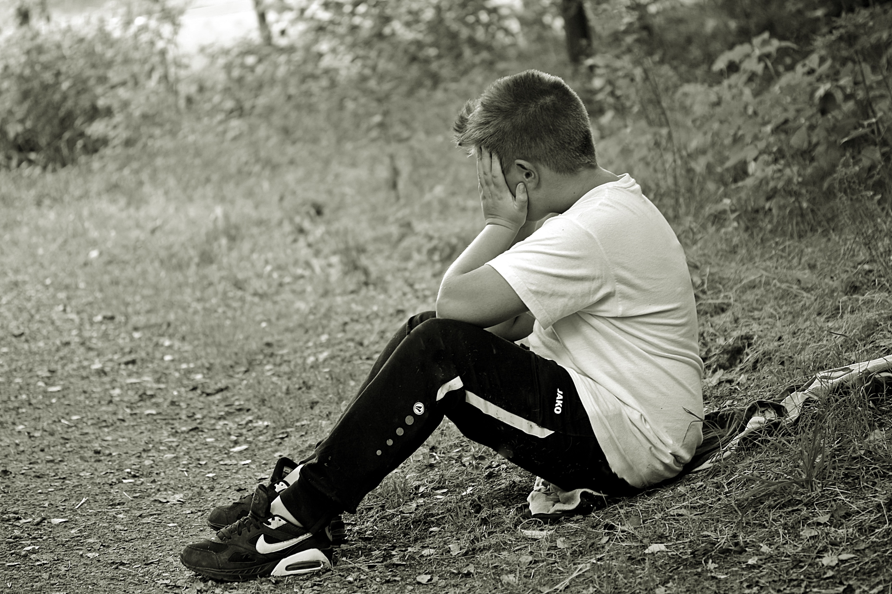
You could also look out for…
If your friend or classmate starts acting differently
If they look worried or can’t concentrate
Anyone who looks sad or alone

Slide 10
What are we doing to help?
PSHE lessons sometimes have anti-bullying themes
Anti bullying week activities in November helps to raise awareness
Anti bullying assemblies
Counselling can be provided through your teachers or intervention sessions
A range of extra-curricular clubs to provide a chance to make new friends
Posters on the new policy have been created
Class anti-bullying ambassadors
Pupils in Spring High have developed an antibullying policy that is easier for you to understand
Teachers have regular communication with parents &carers and pupils

Slide 11
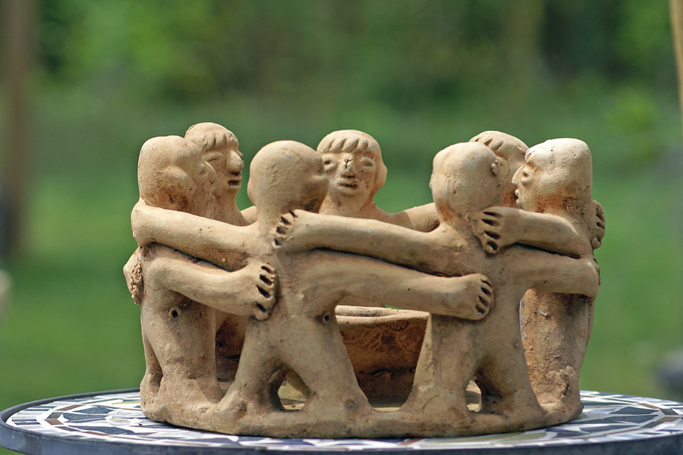
Together we can stop bullying

