Slide 1
English
Advice and guidance
for
Parents and Carers

Slide 2
Our English curriculum
This consists of:-
* Speaking and listening
* Reading
* Writing

Slide 3
Time to Talk
Children need lots of opportunities to talk to others as they practise their speaking and listening skills. This will:
Support social skills and self-esteem.
Develop vocabulary and expression of ideas.
Offer opportunities for children to practise language structure and new words.

Slide 4
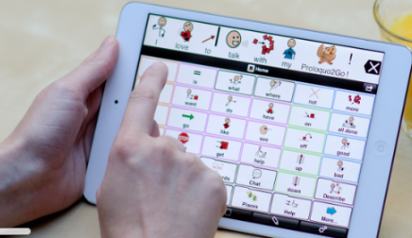
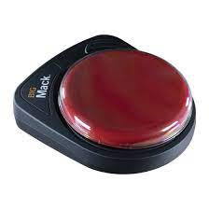
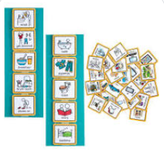
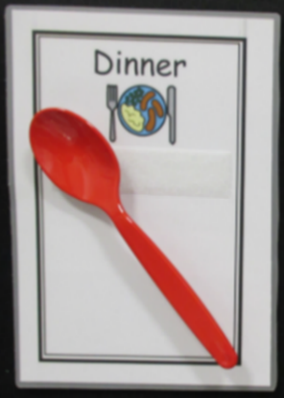
Speaking and listening
AAC:
Switches
Objects of Reference
PECs
Communication mats/books
Signing
iPads
Proloquo - an ipad based communication system

Slide 5
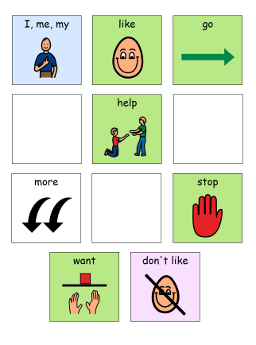
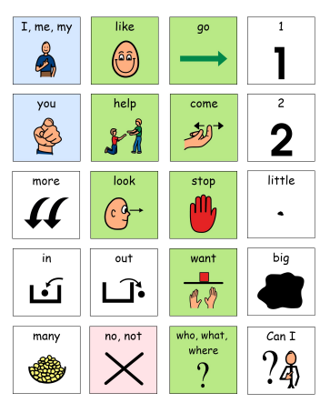
Communication mats
Communication mats/boards/books- are one of the main ways we encourage children to communicate when they are non-verbal and need support with verbally getting a message across. We need to map our language onto the mat- model, model model!

Slide 6
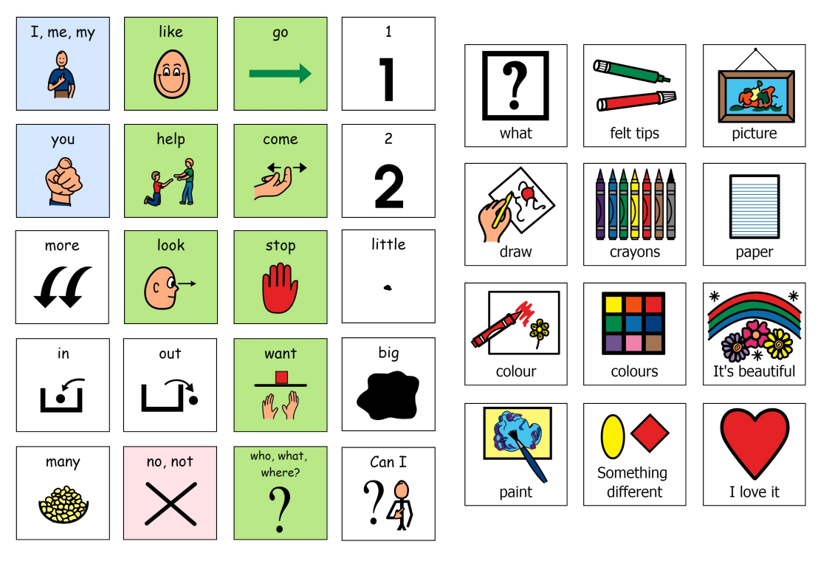

Slide 7
Talking and listening at home
Make time to listen to your child talking –in the car, in the supermarket, at mealtimes, bath times, bedtimes-any time!
Switch off the TV, radio and mobile phones – and really listen!
Make a collection of different toy creatures – for example, a duck,
a snake, an alien, say the sound it might make as you play together
(for example, ‘quack-quack’, ‘sssssss’, ‘yuk-yuk’) and encourage your child to copy you.
Listen at home – switch off the TV and listen to the sounds both
inside and outside the home. Can your child tell you what sounds they
heard, in the order in which they heard them?
Play-a-tune – and follow me! Make or buy some simple shakers,
drums and beaters, then play a simple tune and ask your child to copy.
Have fun!
Use puppets and toys to make up stories or retell known ones.
Record your child telling the story and play it back to them.

Slide 8
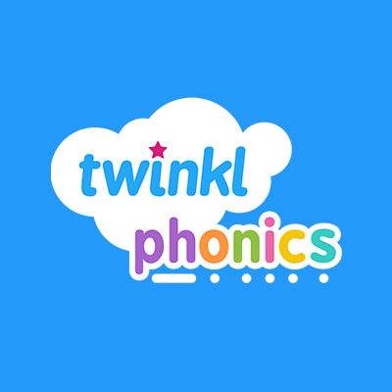
Phonics Twinkl phonics programme Singing songs and rhymes, Listening to music and playing instruments, Playing games that develop a sense of rhythm
Level 1 phonics
Developing attention skills
Developing sound discrimination and comprehension skills
Initial level 2 Phonics
Knowledge and understanding of at least 19 letters.
Practising letter recognition for reading and recall for spelling.

Slide 10
Tuning into Sounds
Games that will help children to listen attentively to sounds around them.
What it means to be a good listener
Encouragement to tune into different sounds and begin to discriminate between them.
Listening to and joining in with rhymes
Games that encourage children to play with words and think of their own rhymes e.g. ‘Humpty Dumpty sat on a mat’.
Humpty Dumpty saw a …’ Encouraging nonsense rhymes is a good way for children to generate and produce rhyme.

Slide 11
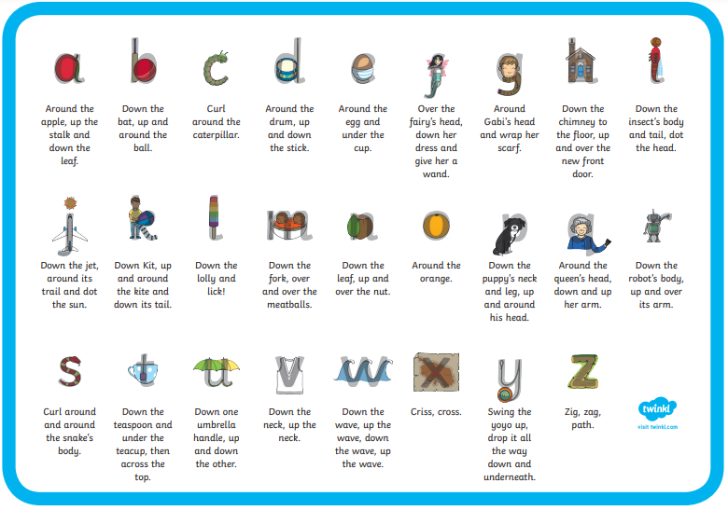
‘Pure sounds’ rather than their letter names. Make the sound as short as you can with no ‘uh’ sound after.

Slide 12
Blending and Segmenting
Blending to read
c-a-t = cat. The separate sounds (phonemes) are spoken aloud, in order, all through the word, and are then merged together into the whole word.
Segmenting to spell
cat = c-a-t. The whole word is spoken aloud and then broken up into its sounds (phonemes)

Slide 13
Ways to help at home
Ways you can support your children at home
Sound-talking
Find real objects around your home that have three phonemes (sounds) and practise ‘sound talk’. First, just let them listen, then see if they will join in, for example, saying:
‘I spy a p-e-g – peg.’
‘I spy a c-u-p – cup.’
‘Where’s your other s-o-ck – sock?’
‘Simon says – put your hands on your h-ea-d.’
Try breaking down simple words when you are giving instructions or
asking questions, such as
“Can you find your h-a-t (hat)?”
“Where is the c-a-t (cat)?”
“Sit on the s-ea-t (seat).”
“Eat your f-oo-d (food).”

Slide 14
Time to Read
Sharing books and stories with your child is fun!
It is a great way to build special memories and moments with your child. It also helps children:
Understand the world around them
Develop vocabulary and learn new words that you would not use in everyday conversations
Different books to explore.
Different books to explore:
Sensory stories – give the children a sense to feel the story as well as listen to it.
Find key words/events on each page to have a sensory activity for.
Think about all the senses- sight/smell/taste/touch/sound/movement.

Slide 19
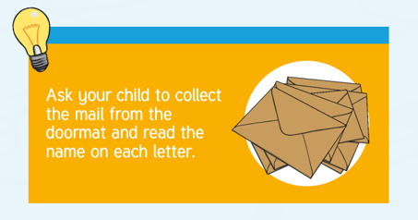
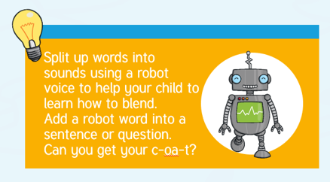
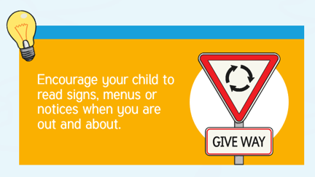

Slide 20
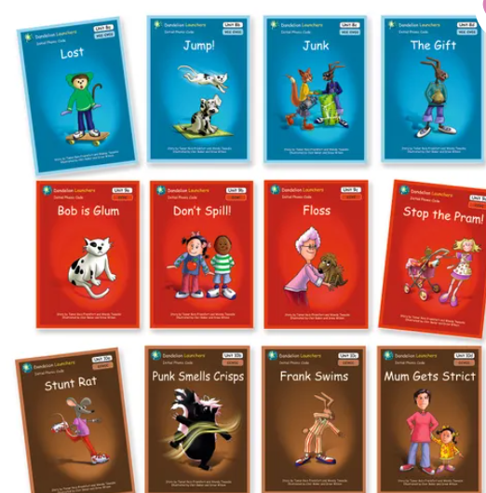
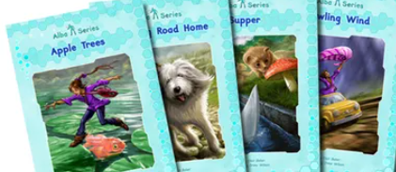
At Springfield school, we use the following reading schemes: Lower school – Twinkl Upper school - has a range including phonics books and letters and sounds Progress is linked to phonics. Beyond phonics – the books increase in difficulty; comprehension; and inference.

Slide 21
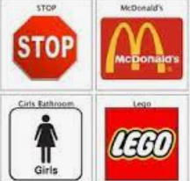
Not all children will learn to read Children may use sight word recognition and Environmental word recognition All children can still enjoy stories

Slide 22
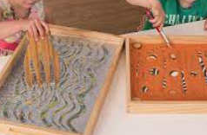
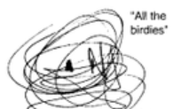
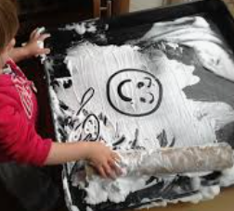
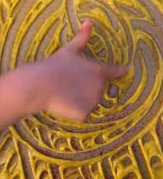
Early writing
Sensory Mark Making – using a wide variety of sensory materials including shaving foam, rice, chocolate, cereal, gloop etc.
Sensory Mark-Making:
Chalks on concrete outside (can make edible chalk paint).
Water and paintbrushes on outside surfaces.
Mark making in sensory trays- flour/foam/rice.
Fine Motor Skill Development:
Threading- cheerios onto spaghetti / pasta onto spaghetti.
Filling and emptying containers in sensory trays.
Jigsaws/ building blocks.
Scribble Stage - this is a form of mark making that purely imitates the idea of writing. The marks will be placed at any point of the page, and will usually involve circular strokes, and random marks.
Giving meaning - children will be able to say, when prompted, what each of these random marks mean.

Slide 23
The Symbolic Stage
Start at any point of the page,
Marks have an intended message.
Perhaps there will be pictures (like smiley faces)
Directional Scribble comes next,. The attempt to write will be written from left to right, usually in a linear place and pattern. Though there won’t be actually words or letters involved (again, this is just a scribble), there will be some intentional message behind the marks.

Slide 24
Mock Letters - this stage of writing development is the child creating their own attempt at letters. At this stage, shapes linking to the story may be used e.g circles for heads to help encourage intentional and more controlled movements

Slide 25
Emergent
Independent emergent writing starts with strings of letters and then groups of letters. They’ll begin to notice that words are grouped letters, and not a single string. They begin to break up their writing, although these letters won’t actually form words yet.

Slide 27
The content of writing then becomes more important, with punctuation and grammar, conjunctions, noun and adverbial phrases becoming a strong feature of the teaching of writing.

Slide 28
At Springfield school, due to the complexity of need of our pupils, moving from one stage of development to another can be a lengthy process.
Opportunities provided for:
Mark-making activities in continuous provision areas
Activities to develop fine-motors skills
Over-writing shapes and letter
Practising letter formation
Practising the spelling of key words
Copying words below a model
Sentence construction activities.

Slide 29
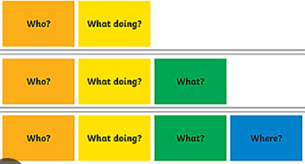
Pupils are provided with a range of alternative means of ‘writing’ such as PECS, symbol-supported writing or computer technology.
Colourful semantics

Slide 30
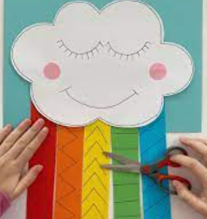
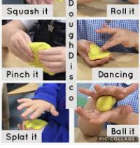
Writing is dependent on hand muscles and fine motor control.
Things to do at home:
Scissor skills
Handwriting
Dough disco
Motor skills

Slide 31
Thank you
Thank you for reading our guide to English.
If you have any further questions about the teaching of English at Springfield School, please do not hesitate to contact your child’s class teacher via Eschools.

